Slide 1






PRESENTATION 2026
FEEDBACK ANALYTICS IN EDUCATION: THE ROLE OF STAKEHOLDERS FEEDBACK IN ACADEMIC EXCELLENCE
Mentor Name
Faculty Email
Faculty Name
Ms.Jyoti
mansi032124@gmail.com
Dr.Mansi Tiwari

Slide 2
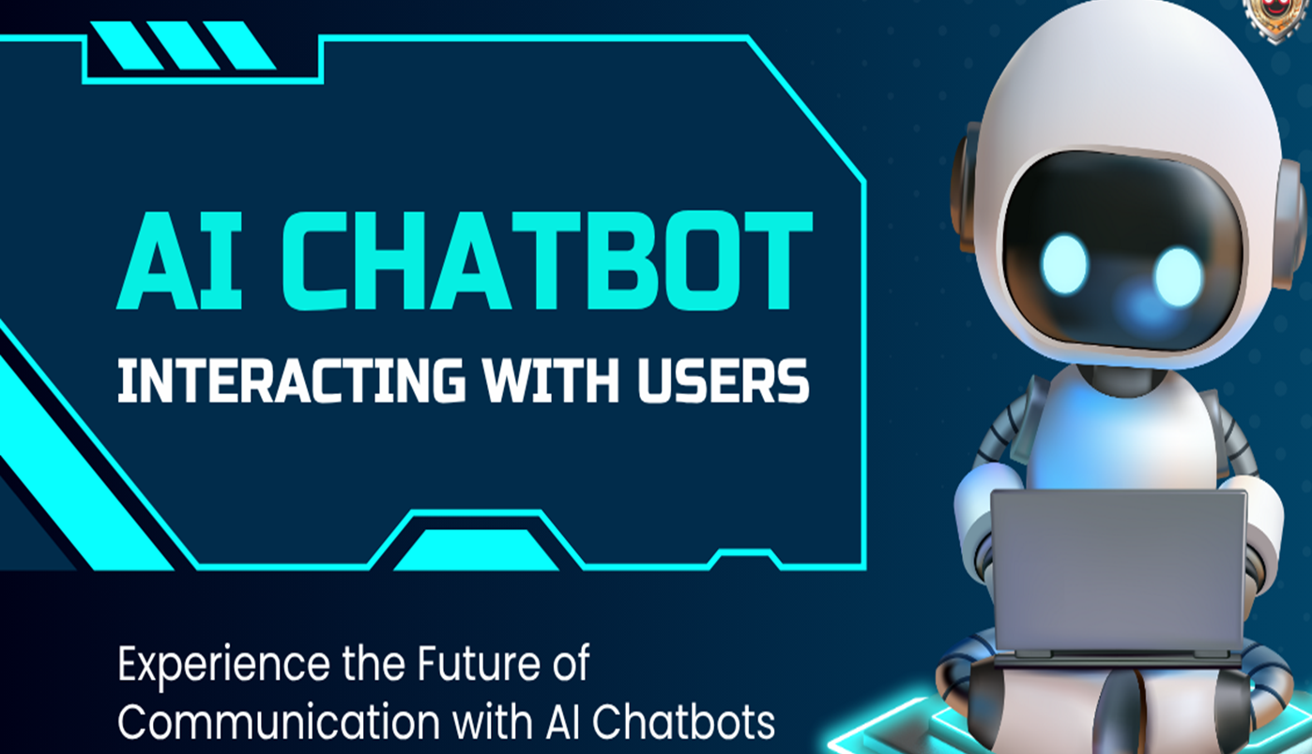

Outline
Abstract of the Project
Objectives
Problem Statement
Tools & Techniques
Proposed Solution
Conclusion
Future Scope

Slide 3
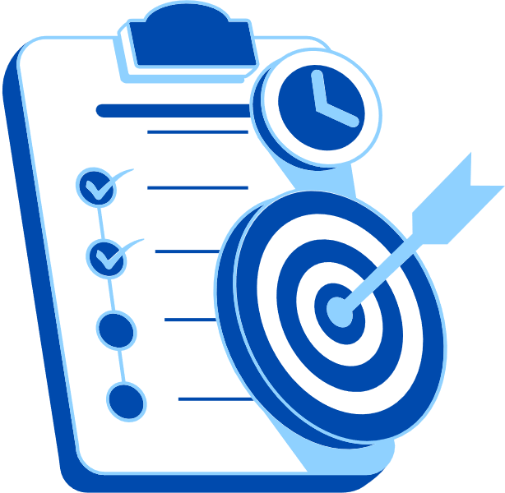
Abstract
Overview
Student feedback is essential for evaluating teaching effectiveness and improving learning outcomes, but large volumes of unstructured data often remain underutilized. Manual analysis is time-consuming, biased, and unable to capture deeper insights. While quantitative feedback is easy to analyze, it lacks context, whereas qualitative feedback is rich but complex to process. This project proposes a Student Feedback & Teaching Improvement Analyzer to automate feedback analysis. Using NLP and machine learning, it will perform sentiment analysis, topic modeling, and trend identification. The system will convert raw feedback into actionable insights, highlighting strengths and areas for improvement.

Slide 4
Objectives
Objectives
List the specific goals your project aims to accomplish-
To automatically collect the stakeholder’s feedback data from integrated platforms without requiring manual intervention.
To prepare the Questions to collect the feedback from various stakeholders.
To categorize feedback into predefined options such as strongly disagree, Disagree, Neutral, Agree & Strongly Agree.
To generate summary reports highlighting the top three strengths from student’s perspectives.
To integrate Microsoft Co-pilot to generate automated teaching improvement summaries and recommendations

Slide 5
Problem Statement
Student feedback is vital for improving teaching and learning outcomes, yet much of it remains underutilized due to its unstructured, subjective, and inconsistent nature, making manual analysis slow and biased. Educational institutions often lack structured, data-driven systems to effectively collect, process, and implement feedback insights. The proposed Student Feedback & Teaching Improvement Analyzer leverages NLP and machine learning to perform sentiment analysis, topic modeling, and trend identification. It transforms raw feedback into actionable insights, enabling educators to identify strengths, address gaps, and enhance overall learning experiences.
The following are the major problem –
1.Ineffective Use of Feedback: Student and stakeholder feedback is often collected but not effectively used to improve teaching–learning processes.
2.Lack of Structured Systems: Educational institutions lack integrated and data-driven systems to systematically collect, analyze, and implement feedback.

Slide 6
Tools & Technologies
Survey Questionnaire → Collected responses multiple stakeholder namely students, faculty, alumni, professionals & employers
Microsoft Excel → Data collation, cleaning, tabulation, and visualization (charts, slicers).
Interactive Dashboards (Excel) → Workload perception, satisfaction indices, stress frequency.
Microsoft Copilot → Insight generation and dashboard assistance.
Google Gemini → Supplemental AI insights and predictive modeling.

Slide 7
Expected Outcomes –
Automated Feedback Collection will automatically gather student feedback from integrated platforms, reducing manual work and ensuring timely and accurate data collection.
A well-designed set of feedback questions will be developed to effectively capture students’ perceptions of teaching quality, course delivery, and learning experience.
Student responses will be systematically categorized into predefined options such as Strongly Disagree, Disagree, Neutral, Agree, and Strongly Agree, enabling consistent analysis and comparison.
The system will generate summary reports highlighting the top three strengths of teaching from students’ perspectives, helping faculty identify their effective teaching practices.
Integration of Microsoft Copilot will provide automated summaries, insights, and recommendations to support faculty in improving teaching strategies and enhancing student learning outcomes.

Slide 8
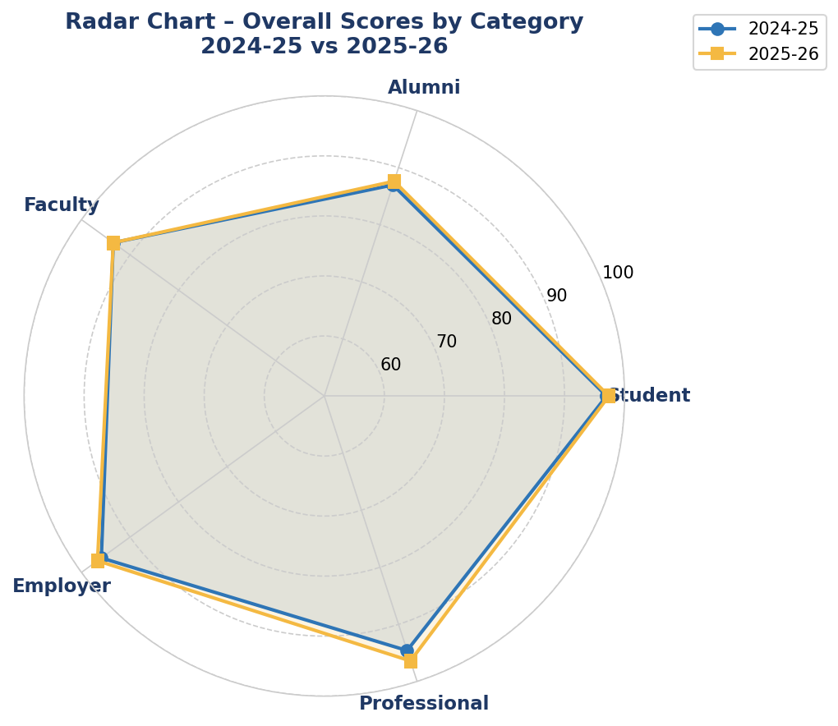
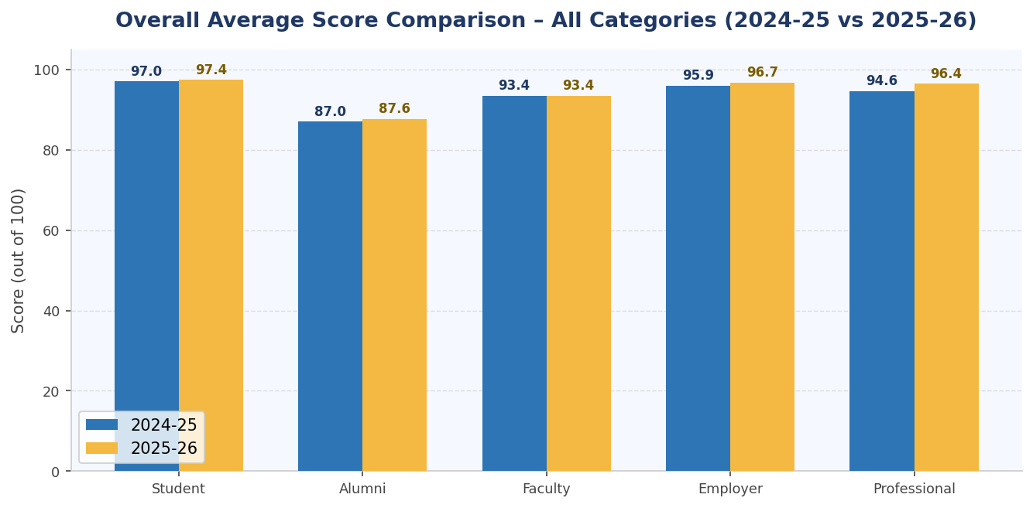
Live Demo of Project – Pie Charts and Bar Charts
Here's the list of some demo screenshots / features of the project:
Demo 1
Demo 2
Demo 1
Overall Feedback Tend through Radar chart of 2024-25 & 2025-26
Overall Average Score Comparison for all categories of stake holders

Slide 9


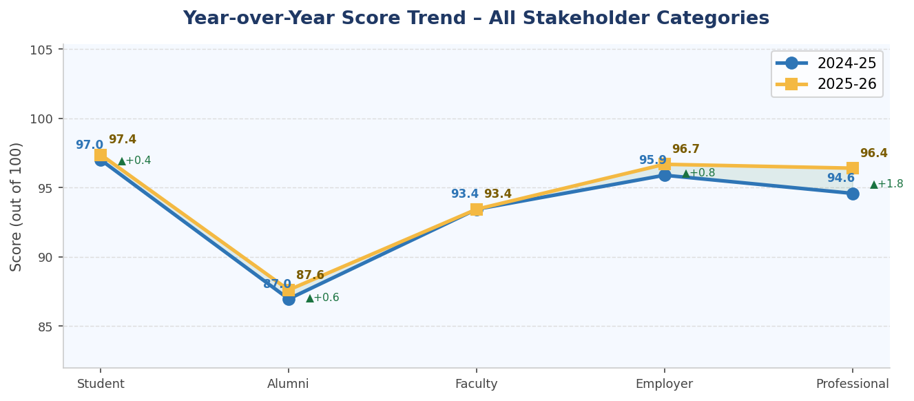
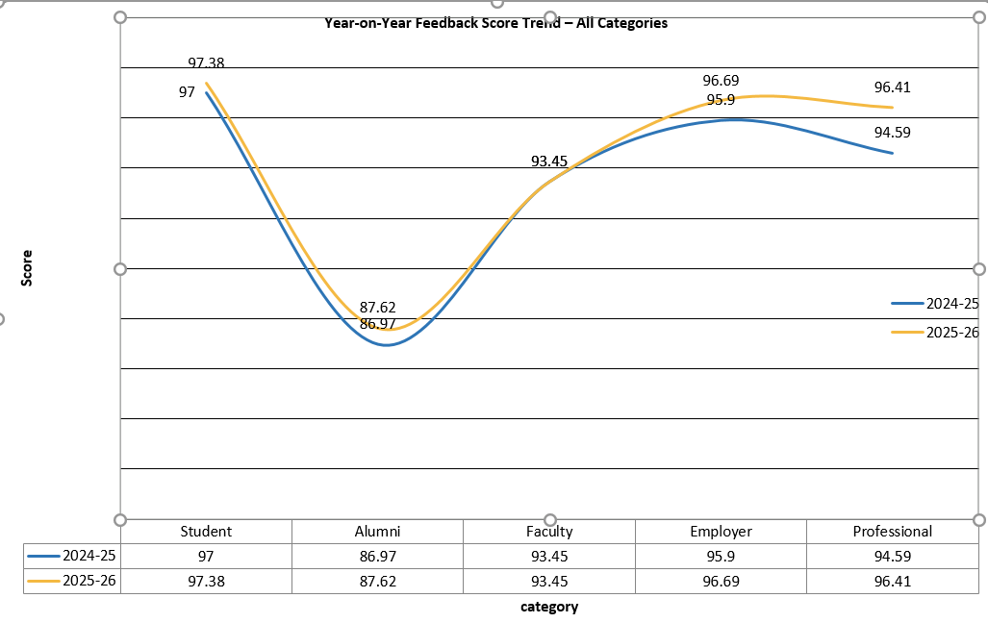
Live Demo of Project – Pie Charts and Bar Charts
Demo - 3
Demo 4
A Trendline chart
A trend Chart showing all categories

Slide 10
Conclusion
All five stakeholder categories show positive or stable scores in 2025-26 compared to 2024-25.
Employer feedback recorded the most significant improvement, reflecting enhanced student placement readiness.
Faculty scores remained consistent, indicating stable academic infrastructure and governance.
Consistently high scores in teaching quality, campus infrastructure, and ethical values development.
Growing respondent base across all categories indicating increased stakeholder trust and participation.
Strong PBL integration and technology-enabled teaching acknowledged by professional stakeholders.
Employer recognition of improved teamwork, soft skills, and innovative thinking in graduates.

Slide 11
Thank You
AICW Fellowship | Faculty Project Presentation 2026
LinkedIn | Edunet Foundation

